Slide 1
CS 110 - Professional Practices in IT Instructor Name : Dr Tariq Umer Email : tariqumer@cuilahore.edu.pk

Slide 2
INTELLECTUAL PROPERTY 2

Slide 3
What We Will Cover
What is Patents
Understanding Trade Secrets
Key Intellectual Property Issues

Slide 4
Patents
Grant of property right to inventors
Issued by the U.S. Patent and Trademark Office (USPTO)
Permits an owner to exclude the public from making, using, or selling the protected invention
Allows legal action against violators
Prevents independent creation as well as copying
Extends only to the United States and its territories and possessions

Slide 5
Patents
Unlike a copyright, a patent prevents independent creation as well as copying.
Even if someone else invents the same item independently and with no prior knowledge of the patent holder’s invention, the second inventor is excluded from using the patented device without permission of the original patent holder.
The USPTO issued 308,853 Utility Grant patents in 2018

Slide 6
Patents
Applicant must file with the (United States Patent and Trademark Office) USPTO (www.uspto.gov)
USPTO searches prior art
Takes an average of 25 months from filing an application until application is issued as a patent or abandoned
Prior art
Existing body of knowledge
Available to a person of ordinary skill in the art

Slide 7
Patents
An invention must pass four tests
Must be in one of the five statutory classes of items
1) processes, (2) machines, (3) manufactures (such as objects made by humans or machines), (4) compositions of matter (such as chemical compounds), and (5) new uses in any of the previous four classes
Must be useful
Must be novel
Must not be obvious to a person having ordinary skill in the same field
Items cannot be patented if they are:
Abstract ideas
Laws of nature
Natural phenomena

Slide 8
Patents
Patent infringement
Making unauthorized use of another’s patent
No specified limit to the monetary penalty
the violation of the rights secured by the owner of a patent, occurs when someone makes unauthorized use of another’s patent.
Software patent
Protects feature, function, or process embodied in instructions executed on a computer
20,000 software-related patents per year have been issued since the early 1980s
Some experts think the number of software patents being granted inhibits new software development

Slide 9
Patents
Before obtaining a software patent, do a patent search
Software Patent Institute is building a database of information
Software cross-licensing agreements
Large software companies agree not to sue each other over patent infringements
Small businesses have no choice but to license patents if they use them
Average patent lawsuit costs $3 - $10 million

Slide 10
Patents
Defensive publishing
Alternative to filing for patents
Company publishes a description of the innovation
Establishes the idea’s legal existence as prior art
Costs mere hundreds of dollars
No lawyers
Fast
Patent troll firm
Acquires patents with no intention of manufacturing anything; instead, licensing the patents to others

Slide 11
Patents
Standard is a definition or format
Approved by recognized standards organization or accepted as a de facto standard by the industry
Enables hardware and software from different manufacturers to work together
Standards exist for communication protocols, programming languages, operating systems, data formats, and electrical interfaces.
Submarine patent
Patented process/invention hidden within a standard
Does not surface until standard is broadly adopted
Notes:
De jure standards, or standards according to law, are endorsed by a formal standards organization
De facto standards, or standards in actuality, are adopted widely by an industry and its customers.

Slide 12
Patents
Patent farming involves:
Influencing a standards organization to make use of a patented item without revealing the existence of the patent
Demanding royalties from all parties that use the standard

Slide 13
Trade Secrets
Trade secret
Business information
Represents something of economic value
Requires an effort or cost to develop
Some degree of uniqueness or novelty
Generally unknown to the public
Kept confidential
Information is only considered a trade secret if the company takes steps to protect it

Slide 14
Trade Secrets
Trade secret law has a few key advantages over patents and copyrights
No time limitations
No need to file an application
Patents can be ruled invalid by courts
No filing or application fees
Law doesn’t prevent someone from using the same idea if it is developed independently
Trade secret law varies greatly from country to country

Slide 15
Trade Secret Laws
Uniform Trade Secrets Act (UTSA)
Established uniformity across the states in area of trade secret law
Computer hardware and software can qualify for trade secret protection
The Economic Espionage Act (EEA) of 1996
Penalties of up to $10 million and 15 years in prison for the theft of trade secrets

Slide 16
Employees and Trade Secrets
Employees are the greatest threat to trade secrets
Unauthorized use of an employer’s customer list
Customer list is not automatically considered a trade secret
Educate workers about the confidentiality of lists
Nondisclosure clauses in employee’s contract
Enforcement can be difficult
Confidentiality issues are reviewed at the exit interview

Slide 17
Employees and Trade Secrets
Non-compete agreements
Protect intellectual property from being used by competitors when key employees leave
Require employees not to work for competitors for a period of time
Wide range of treatment on noncompete agreements among the various states

Slide 18
End of Lecture 9 a

Slide 19
Lecture -9b Key Intellectual Property Issues

Slide 20
Key Intellectual Property Issues
Issues that apply to intellectual property and information technology
Plagiarism
Reverse engineering
Open source code
Competitive intelligence
Trademark infringement

Slide 21
Plagiarism
Stealing someone’s ideas or words and passing them off as one’s own
Many students:
Do not understand what constitutes plagiarism
Believe that all electronic content is in the public domain
Plagiarism is also common outside academia
Plagiarism detection systems
Check submitted material against databases of electronic content

Slide 22
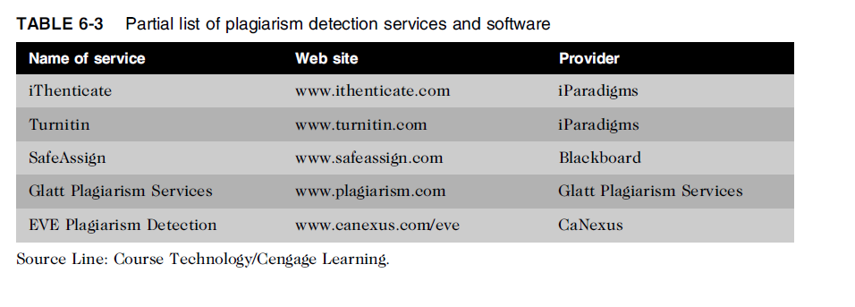
Plagiarism

Slide 23
Plagiarism
Steps to combat student plagiarism
Help students understand what constitutes plagiarism and why they need to cite sources
Show students how to document Web pages
Schedule major writing assignments in portions due over the course of the term
Tell students that instructors are aware of Internet paper mills and plagiarism detection services
Incorporate detection into an anti-plagiarism program

Slide 24
Reverse Engineering
Process of taking something apart in order to:
Understand it
Build a copy of it
Improve it
Applied to computer:
Hardware
Software
Convert a program code to a higher-level design
Convert an application that ran on one vendor’s database to run on another’s
Code-generation tools can be used to take the design and produce code (forward engineer)
Process by which a human-made object/scientific research is deconstructed to reveal its designs, architecture, or to extract knowledge from the object

Slide 25
Reverse Engineering
Compiler
Language translator
Converts computer program statements expressed in a source language to machine language
Software manufacturer
Provides software in machine language form
Decompiler
Reads machine language
Produces source code
REC is a decompiler that reads an executable machine-language file and produces a C-like representation of the code used to build the program.

Slide 26
Reverse Engineering
Courts have ruled in favor of reverse engineering:
To enable interoperability
Software license agreements forbid reverse engineering
Ethics of using reverse engineering are debated
Fair use of it provides useful function/interoperability
Can uncover designs that someone else has developed at great cost and taken care to protect

Slide 27
Open Source Code
Program source code made available for use or modification:
As users or other developers see fit
Basic premise
Many programmers can help software improve
Can be adapted to meet new needs
Bugs rapidly identified and fixed
High reliability

Slide 28
Competitive Intelligence
Gathering of legally obtainable information
To help a company gain an advantage over rivals
Often integrated into a company’s strategic plans and decision making
Not the same as industrial espionage, which uses illegal means to obtain business information not available to the general public
Without proper management safeguards, it can cross over to industrial espionage

Slide 29
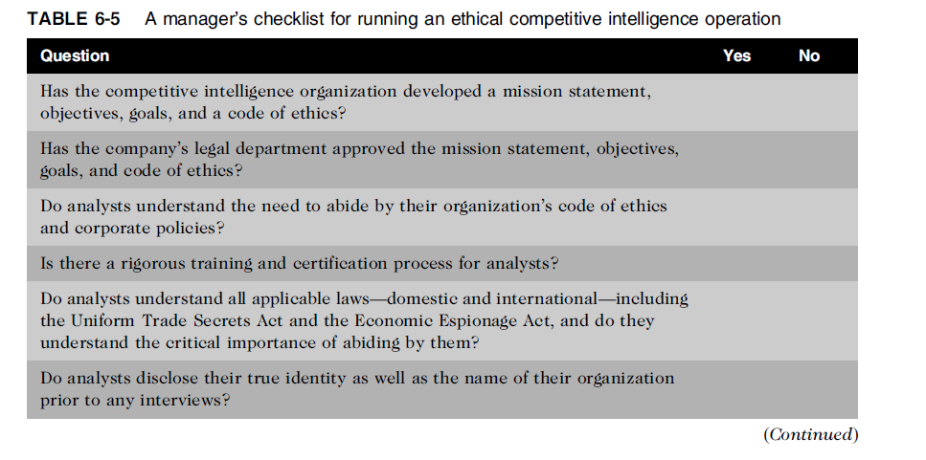
Competitive Intelligence (cont’d.)

Slide 30
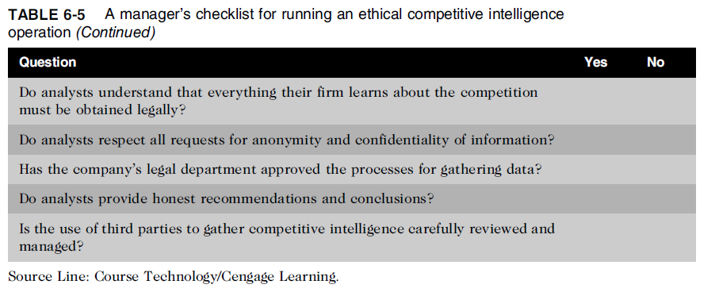
Competitive Intelligence (cont’d.)

Slide 31
Trademark Infringement
Trademark is logo, package design, phrase, sound, or word that enables consumer to differentiate one company’s product from another’s
Trademark owner can prevent others from using the same mark or a confusingly similar mark on a product’s label
Organizations frequently sue one another over the use of a trademark in a Web site or domain name
Nominative fair use is defense often employed by defendant in trademark infringement case

